Slide 1

Assignment 2: Data Analysis
Kussainova Assem

Slide 2

Goals
Describe the data to be analyzed
Identify appropriate methods and software for analysis of data
Explore the patterns, trends and dependencies within the data and make conclusions

Slide 3

Dataset
The High School and Beyond data set (hsb) is from a large-scale longitudinal study conducted by the National Opinion Research Center (1980) under contract with the National Center for Education Statistics.
Observations: 200
Variables: 11

Slide 4
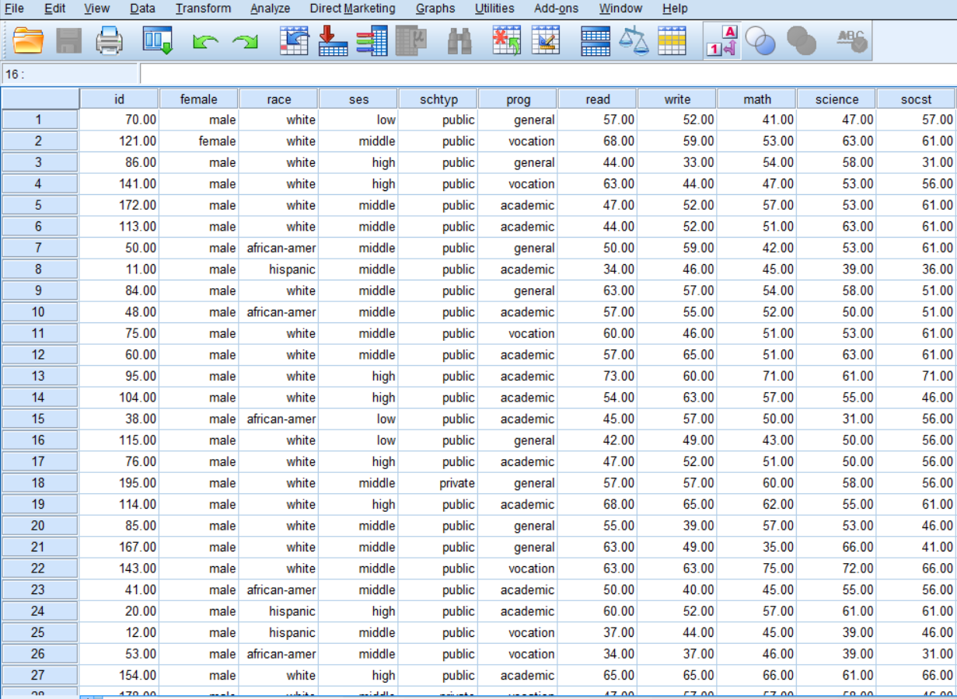
High School and Beyond Survey 2 dataset

Slide 5

Study Questions
Does type of program influence on total test results of students?
Is there a relationship between type of program students enrolled and their socioeconomic status? If yes, does this relationship affect the results of reading test?
Can we predict writing scores for students according their gender and other test results?

Slide 6
Analysis
1. Effect of program on students’ test results
Methods: one-way ANOVA, Post Hock test
Main assumptions for test:
- Normal distribution of data
- Homogeneity of variances should be assumed

Slide 7
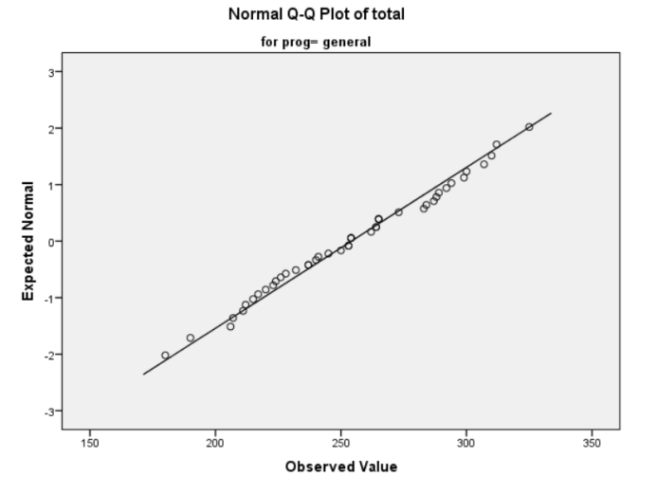
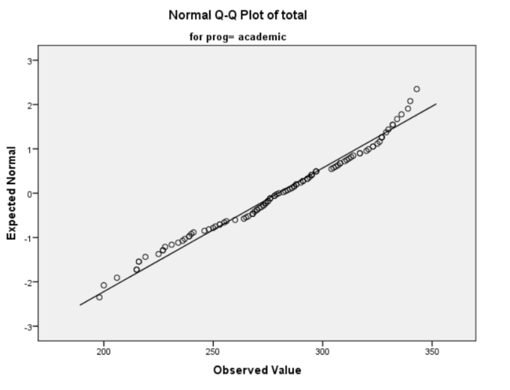
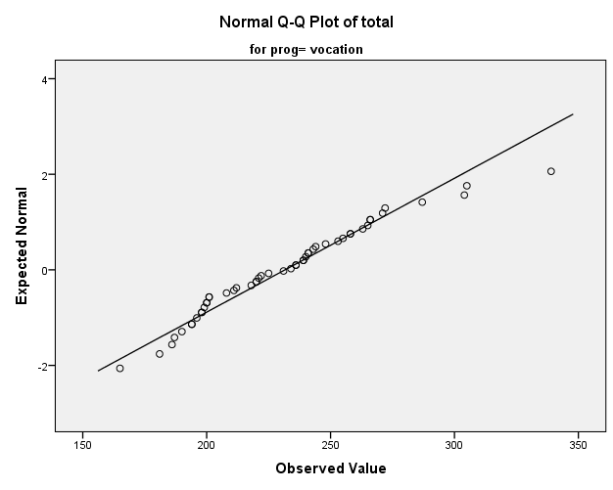
Normality test
Conclusion: Normality can be assumed

Slide 8
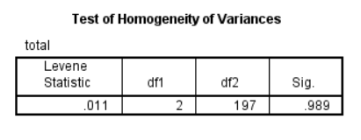
Homogeneity of variance
𝐻0: homogeneity of variance of students’ total score within programs can be assumed
𝐻1: homogeneity of variance of students’ total score within programs cannot be assumed
sig. = 0.989 (p > 0.05)
Test is non-significant
Accept H0
Conclusion: homogeneity of variances of total test scores within different programs can be assumed

Slide 9
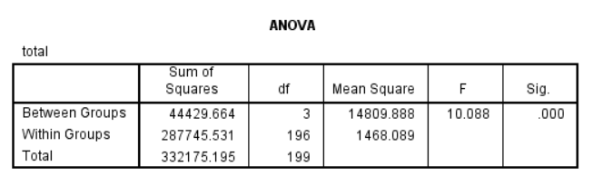
One-way ANOVA
𝐻0: mean of total test scores doesn’t differ between three program types
𝐻1: mean of total test scores differs between three program types
sig. = 0.000003 (p < 0.05)
Test is significant
Reject H0
Conclusion: mean of total test scores differs between three program types

Slide 10
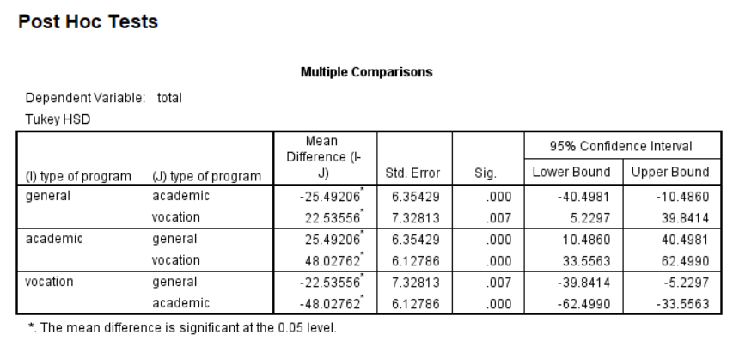
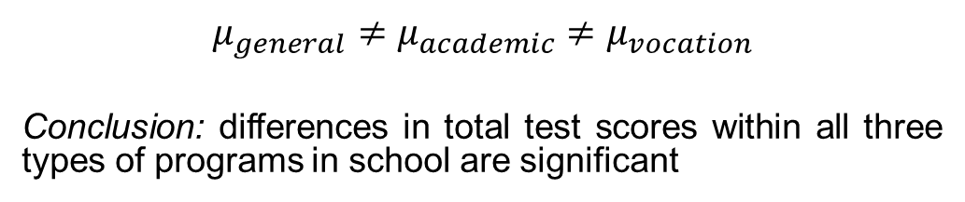
Post Hock test
$$μ_{general}≠μ_{academic}≠μ_{vocation}$$
Conclusion: differences in total test scores within all three types of programs in school are significant

Slide 11
Conclusion
Question: Does type of program influence on total test results of students?
Answer: Yes, type of program in school strongly influence on total test results of students.
Mean diff. (academic, general) = 25.49
Mean diff. (general, vocation) = 22.53
Mean diff. (academic, vocation) = 48.03

Slide 12
Analysis
2. Relationship between type of program and socioeconomic status
Methods: Chi-squared test, two-way ANOVA,
Post Hock test
Main assumptions for Chi-squared test:
- Two variables should be measured at an
ordinal or nominal level (i.e., categorical data)
- Two variables should consist of two or more
categorical, independent groups.

Slide 13
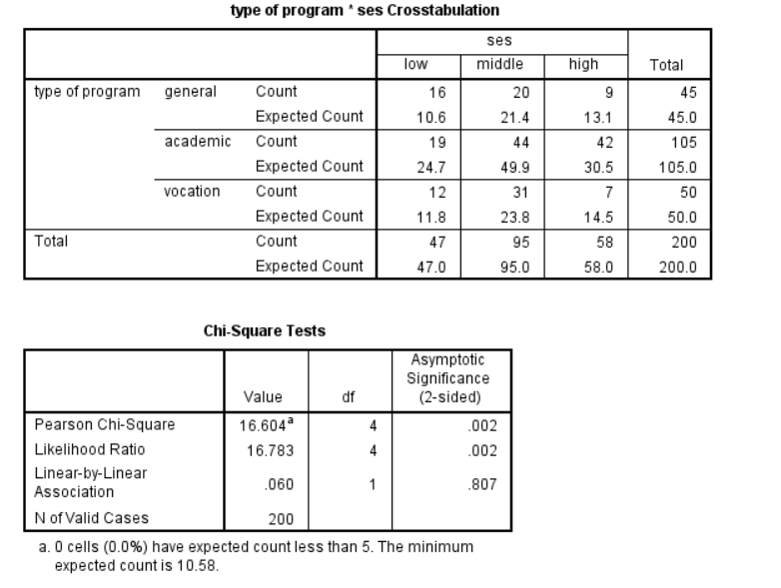
Chi-squared test
𝐻0: 𝑇ℎ𝑒𝑟𝑒 𝑖𝑠 𝑛𝑜 𝑎𝑠𝑠𝑜𝑐𝑖𝑎𝑡𝑖𝑜𝑛 𝑏𝑒𝑡𝑤𝑒𝑒𝑛 𝑡𝑦𝑝𝑒 𝑜𝑓 𝑝𝑟𝑜𝑔𝑟𝑎𝑚 𝑎𝑛𝑑 𝑠𝑜𝑐𝑖𝑜𝑒𝑐𝑜𝑛𝑜𝑚𝑖𝑐 𝑠𝑡𝑎𝑡𝑢𝑠
𝐻1: 𝑇ℎ𝑒𝑟𝑒 𝑖𝑠 𝑎𝑛 𝑎𝑠𝑠𝑜𝑐𝑖𝑎𝑡𝑖𝑜𝑛 𝑏𝑒𝑡𝑤𝑒𝑒𝑛 𝑡𝑦𝑝𝑒 𝑜𝑓 𝑝𝑟𝑜𝑔𝑟𝑎𝑚 𝑎𝑛𝑑 𝑠𝑜𝑐𝑖𝑜𝑒𝑐𝑜𝑛𝑜𝑚𝑖𝑐 𝑠𝑡𝑎𝑡𝑢𝑠
sig. = 0.002 (p < 0.05)
Test is significant
Reject H0
Conclusion: There is an association between type of program and socioeconomic status

Slide 14
Analysis
Main assumptions for two-way ANOVA:
- Dependent variable should be approximately normally distributed for each combination of the groups of the two independent variables.
- There needs to be homogeneity of variances for each combination of the groups of the two independent variables.

Slide 15
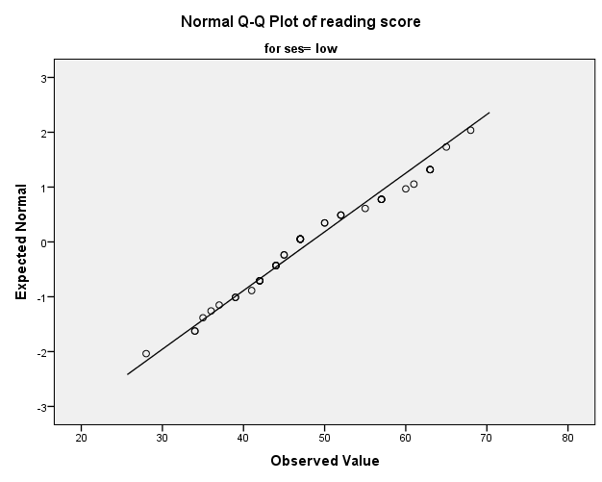
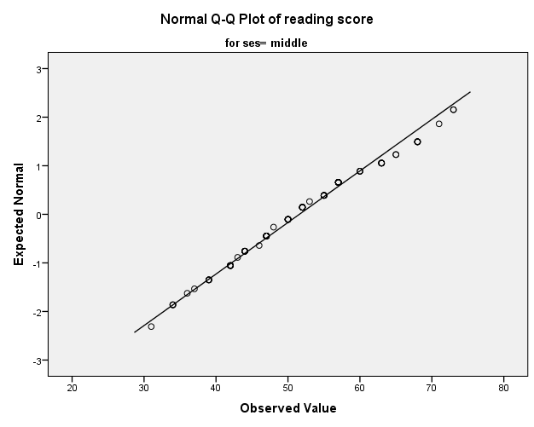
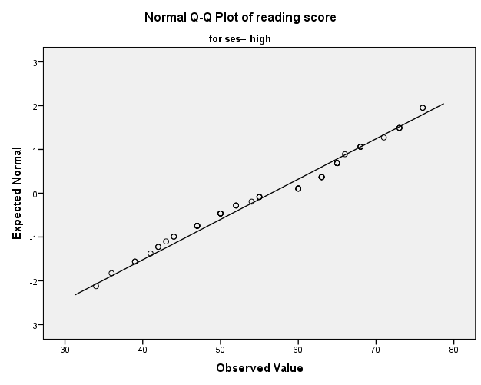
First normality test
Conclusion: Normality of data within socioeconomic status can be assumed

Slide 16
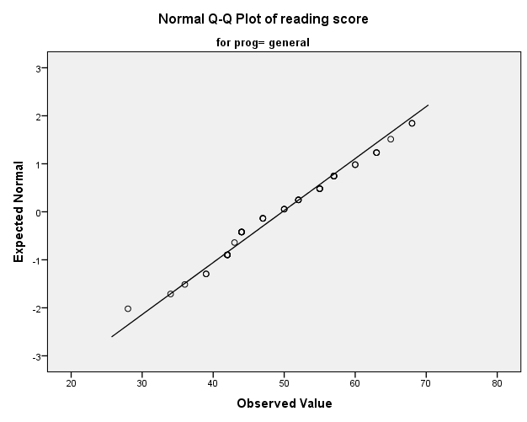
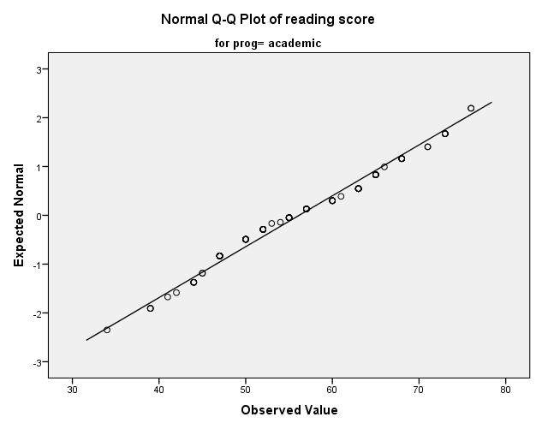
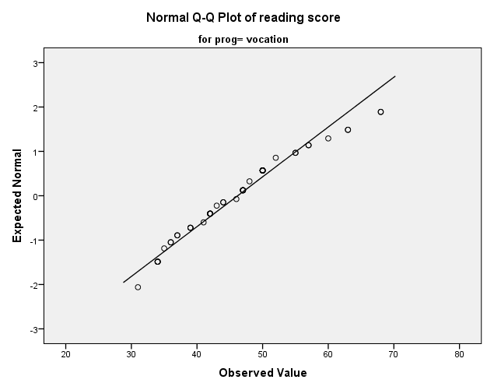
Second normality test
Conclusion: Normality of data within type of program can be assumed

Slide 17
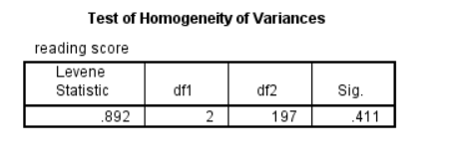
Homogeneity of variance
𝐻0: ℎ𝑜𝑚𝑜𝑔𝑒𝑛𝑒𝑖𝑡𝑦 𝑜𝑓 𝑣𝑎𝑟𝑖𝑎𝑛𝑐𝑒𝑠 𝑜𝑓 𝑟𝑒𝑎𝑑𝑖𝑛𝑔 𝑠𝑐𝑜𝑟𝑒𝑠 𝑤𝑖𝑡ℎ𝑖𝑛 𝑡𝑦𝑝𝑒𝑠 𝑜𝑓 𝑝𝑟𝑜𝑔𝑟𝑎𝑚 𝑐𝑎𝑛 𝑏𝑒 𝑎𝑠𝑠𝑢𝑚𝑒𝑑
𝐻1: ℎ𝑜𝑚𝑜𝑔𝑒𝑛𝑒𝑖𝑡𝑦 𝑜𝑓 𝑣𝑎𝑟𝑖𝑎𝑛𝑐𝑒𝑠 𝑜𝑓 𝑟𝑒𝑎𝑑𝑖𝑛𝑔 𝑠𝑐𝑜𝑟𝑒𝑠 𝑤𝑖𝑡ℎ𝑖𝑛 𝑡𝑦𝑝𝑒𝑠 𝑜𝑓 𝑝𝑟𝑜𝑔𝑟𝑎𝑚 𝑐𝑎𝑛𝑛𝑜𝑡 𝑏𝑒 𝑎𝑠𝑠𝑢𝑚𝑒𝑑
sig. = 0.411 (p > 0.05)
Test is non-significant
Accept H0
Conclusion: homogeneity of variances of reading scores within types of program can be assumed

Slide 18
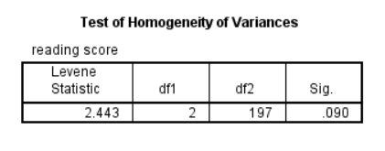
Homogeneity of variance
𝐻0: ℎ𝑜𝑚𝑜𝑔𝑒𝑛𝑒𝑖𝑡𝑦 𝑜𝑓 𝑣𝑎𝑟𝑖𝑎𝑛𝑐𝑒𝑠 𝑜𝑓 𝑟𝑒𝑎𝑑𝑖𝑛𝑔 𝑠𝑐𝑜𝑟𝑒𝑠 𝑤𝑖𝑡ℎ𝑖𝑛 𝑠𝑜𝑐𝑖𝑜𝑒𝑐𝑜𝑛𝑜𝑚𝑖𝑐 𝑠𝑡𝑎𝑡𝑢𝑠
𝑐𝑎𝑛 𝑏𝑒 𝑎𝑠𝑠𝑢𝑚𝑒𝑑
𝐻1: ℎ𝑜𝑚𝑜𝑔𝑒𝑛𝑒𝑖𝑡𝑦 𝑜𝑓 𝑣𝑎𝑟𝑖𝑎𝑛𝑐𝑒𝑠 𝑜𝑓 𝑟𝑒𝑎𝑑𝑖𝑛𝑔 𝑠𝑐𝑜𝑟𝑒𝑠 𝑤𝑖𝑡ℎ𝑖𝑛 𝑠𝑜𝑐𝑖𝑜𝑒𝑐𝑜𝑛𝑜𝑚𝑖𝑐 𝑠𝑡𝑎𝑡𝑢𝑠
𝑐𝑎𝑛𝑛𝑜𝑡 𝑏𝑒 𝑎𝑠𝑠𝑢𝑚𝑒𝑑
sig. = 0.09 (p > 0.05)
Test is non-significant
Accept H0
Conclusion: homogeneity of variances of reading scores within socioeconomic status can be assumed

Slide 19
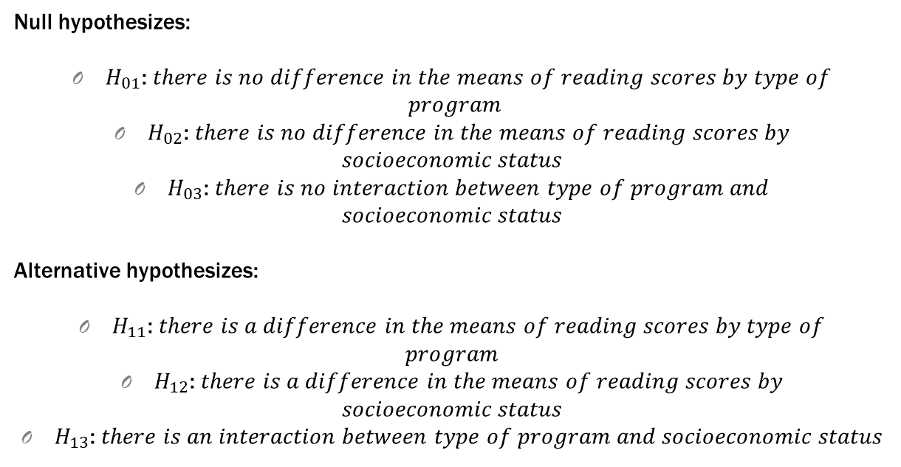
Two-way ANOVA
Null hypothesizes:
$H_{01}$: 𝑡ℎ𝑒𝑟𝑒 𝑖𝑠 𝑛𝑜 𝑑𝑖𝑓𝑓𝑒𝑟𝑒𝑛𝑐𝑒 𝑖𝑛 𝑡ℎ𝑒 𝑚𝑒𝑎𝑛𝑠 𝑜𝑓 𝑟𝑒𝑎𝑑𝑖𝑛𝑔 𝑠𝑐𝑜𝑟𝑒𝑠 𝑏𝑦 𝑡𝑦𝑝𝑒 𝑜𝑓
𝑝𝑟𝑜𝑔𝑟𝑎𝑚
$H_{02}$: 𝑡ℎ𝑒𝑟𝑒 𝑖𝑠 𝑛𝑜 𝑑𝑖𝑓𝑓𝑒𝑟𝑒𝑛𝑐𝑒 𝑖𝑛 𝑡ℎ𝑒 𝑚𝑒𝑎𝑛𝑠 𝑜𝑓 𝑟𝑒𝑎𝑑𝑖𝑛𝑔 𝑠𝑐𝑜𝑟𝑒𝑠 𝑏𝑦
𝑠𝑜𝑐𝑖𝑜𝑒𝑐𝑜𝑛𝑜𝑚𝑖𝑐 𝑠𝑡𝑎𝑡𝑢𝑠
$H_{03}$: 𝑡ℎ𝑒𝑟𝑒 𝑖𝑠 𝑛𝑜 𝑖𝑛𝑡𝑒𝑟𝑎𝑐𝑡𝑖𝑜𝑛 𝑏𝑒𝑡𝑤𝑒𝑒𝑛 𝑡𝑦𝑝𝑒 𝑜𝑓 𝑝𝑟𝑜𝑔𝑟𝑎𝑚 𝑎𝑛𝑑
𝑠𝑜𝑐𝑖𝑜𝑒𝑐𝑜𝑛𝑜𝑚𝑖𝑐 𝑠𝑡𝑎𝑡𝑢𝑠
Alternative hypothesizes:
$H_{11}$: 𝑡ℎ𝑒𝑟𝑒 𝑖𝑠 𝑎 𝑑𝑖𝑓𝑓𝑒𝑟𝑒𝑛𝑐𝑒 𝑖𝑛 𝑡ℎ𝑒 𝑚𝑒𝑎𝑛𝑠 𝑜𝑓 𝑟𝑒𝑎𝑑𝑖𝑛𝑔 𝑠𝑐𝑜𝑟𝑒𝑠 𝑏𝑦 𝑡𝑦𝑝𝑒 𝑜𝑓
𝑝𝑟𝑜𝑔𝑟𝑎𝑚
$H_{12}$: 𝑡ℎ𝑒𝑟𝑒 𝑖𝑠 𝑎 𝑑𝑖𝑓𝑓𝑒𝑟𝑒𝑛𝑐𝑒 𝑖𝑛 𝑡ℎ𝑒 𝑚𝑒𝑎𝑛𝑠 𝑜𝑓 𝑟𝑒𝑎𝑑𝑖𝑛𝑔 𝑠𝑐𝑜𝑟𝑒𝑠 𝑏𝑦
𝑠𝑜𝑐𝑖𝑜𝑒𝑐𝑜𝑛𝑜𝑚𝑖𝑐 𝑠𝑡𝑎𝑡𝑢𝑠
$H_{13}$: 𝑡ℎ𝑒𝑟𝑒 𝑖𝑠 𝑎𝑛 𝑖𝑛𝑡𝑒𝑟𝑎𝑐𝑡𝑖𝑜𝑛 𝑏𝑒𝑡𝑤𝑒𝑒𝑛 𝑡𝑦𝑝𝑒 𝑜𝑓 𝑝𝑟𝑜𝑔𝑟𝑎𝑚 𝑎𝑛𝑑 𝑠𝑜𝑐𝑖𝑜𝑒𝑐𝑜𝑛𝑜𝑚𝑖𝑐 𝑠𝑡𝑎𝑡𝑢𝑠

Slide 20
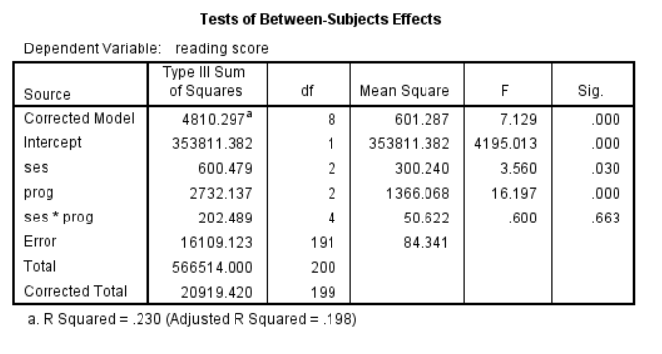
Two-way ANOVA
Conclusion: 𝑡ℎ𝑒𝑟𝑒 𝑖𝑠 𝑎 𝑑𝑖𝑓𝑓𝑒𝑟𝑒𝑛𝑐𝑒 𝑖𝑛 𝑡ℎ𝑒 𝑚𝑒𝑎𝑛𝑠 𝑜𝑓 𝑟𝑒𝑎𝑑𝑖𝑛𝑔 𝑠𝑐𝑜𝑟𝑒𝑠 𝑏𝑦 𝑡𝑦𝑝𝑒 𝑜𝑓 𝑝𝑟𝑜𝑔𝑟𝑎𝑚; 𝑡ℎ𝑒𝑟𝑒 𝑖𝑠 𝑎 𝑑𝑖𝑓𝑓𝑒𝑟𝑒𝑛𝑐𝑒 𝑖𝑛 𝑡ℎ𝑒 𝑚𝑒𝑎𝑛𝑠 𝑜𝑓 𝑟𝑒𝑎𝑑𝑖𝑛𝑔
𝑠𝑐𝑜𝑟𝑒𝑠 𝑏𝑦 𝑠𝑜𝑐𝑖𝑜𝑒𝑐𝑜𝑛𝑜𝑚𝑖𝑐 𝑠𝑡𝑎𝑡𝑢𝑠; 𝑡ℎ𝑒𝑟𝑒 𝑖𝑠 𝑛𝑜 𝑖𝑛𝑡𝑒𝑟𝑎𝑐𝑡𝑖𝑜𝑛 𝑏𝑒𝑡𝑤𝑒𝑒𝑛
𝑡𝑦𝑝𝑒 𝑜𝑓 𝑝𝑟𝑜𝑔𝑟𝑎𝑚 𝑎𝑛𝑑 𝑠𝑜𝑐𝑖𝑜𝑒𝑐𝑜𝑛𝑜𝑚𝑖𝑐 𝑠𝑡𝑎𝑡𝑢𝑠.

Slide 21
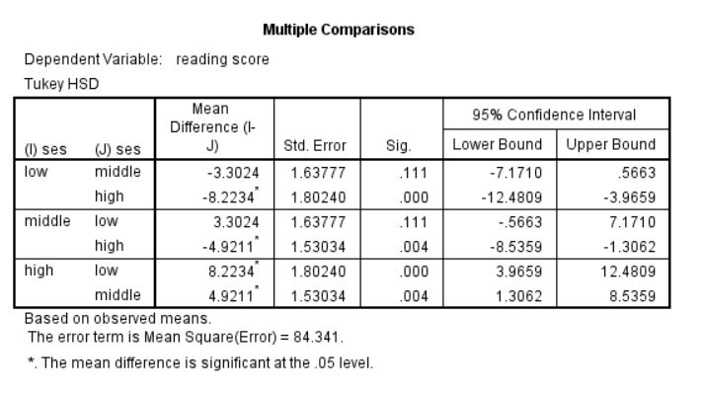
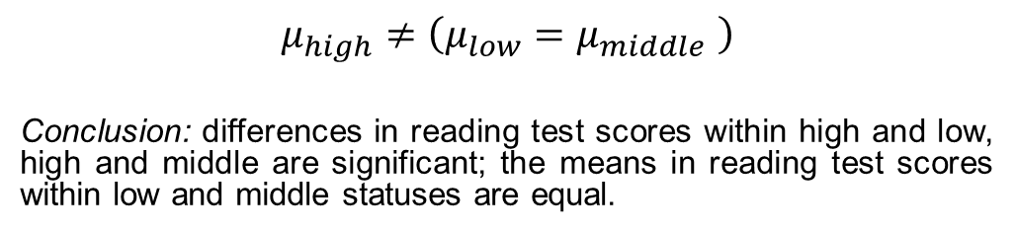
Post Hock test
$$μ_{high}≠\left(μ_{low}=μ_{middle} \right)$$
Conclusion: differences in reading test scores within high and low, high and middle are significant; the means in reading test scores within low and middle statuses are equal.

Slide 22
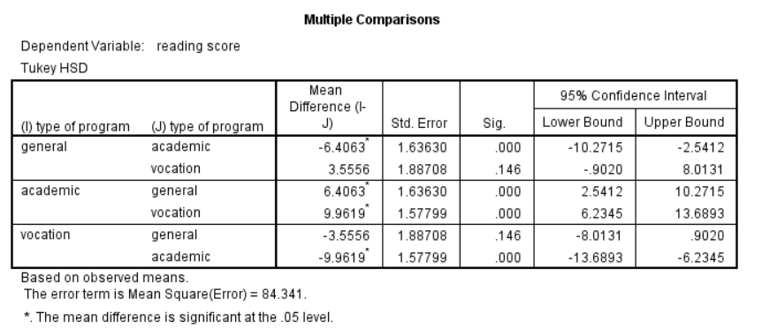
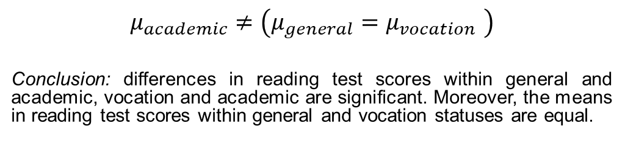
Post Hock test
$$μ_{academic}≠\left(μ_{general}=μ_{vocation} \right)$$
Conclusion: differences in reading test scores within general and academic, vocation and academic are significant. Moreover, the means in reading test scores within general and vocation statuses are equal.

Slide 23
Conclusion
Question: Is there a relationship between type of program students enrolled and their socioeconomic status? If yes, does this relationship affect the results of reading test?
Answer: Yes, there a relationship between type of program students enrolled and their socioeconomic status. However, there was not statistically significant interaction between the effects of socioeconomic status and type of program on reading score, p = .663

Slide 24
Analysis
3. Writing score prediction
Methods: multiple regression
Main assumptions for test:
- normality of data
- no multicollinearity between variables

Slide 25
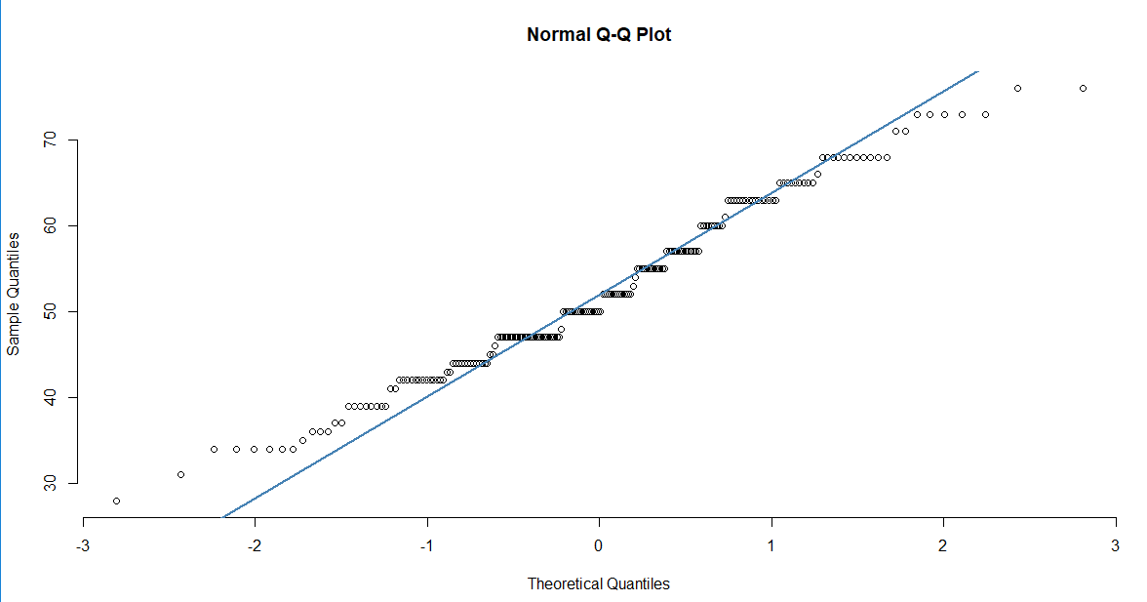
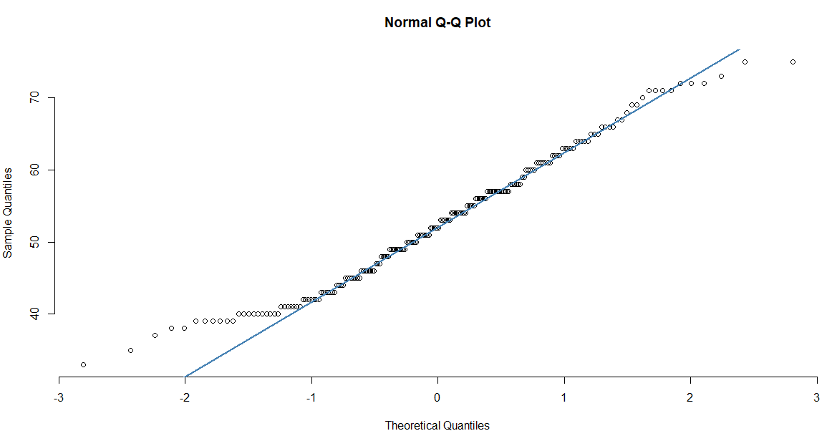
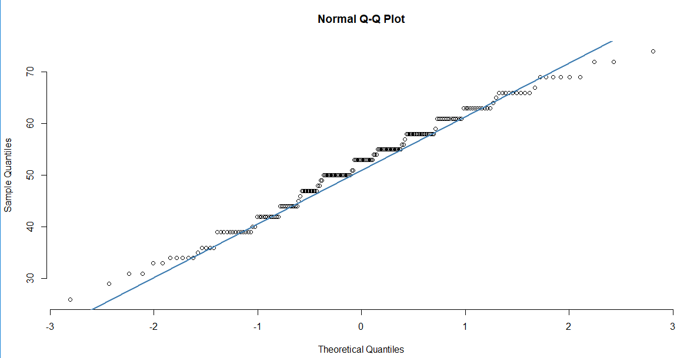
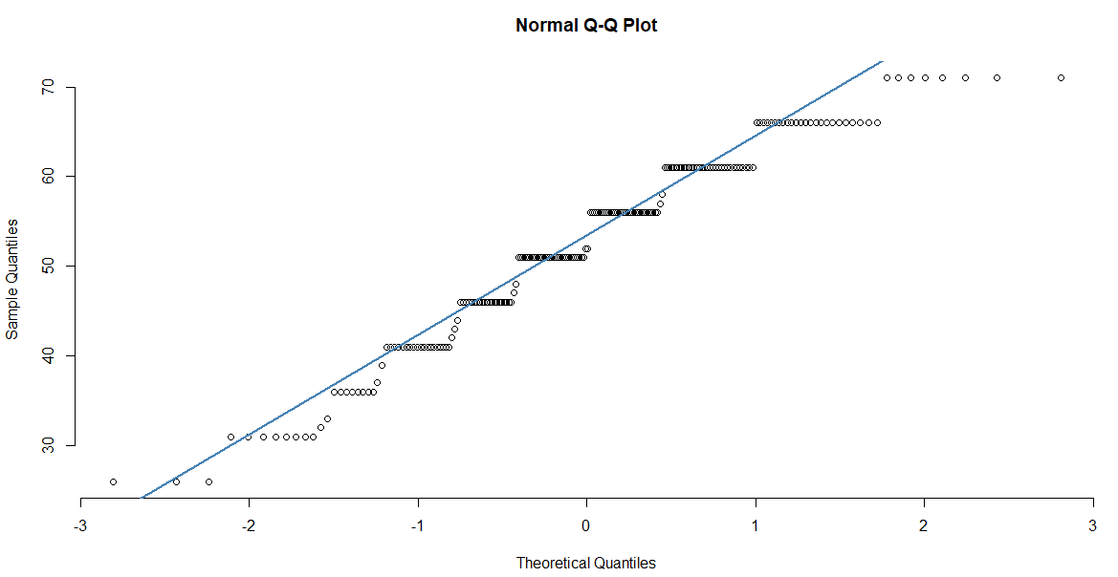
Normality test
Conclusion: Normality of gender and test results data can be assumed

Slide 26

Multicollinearity
Conclusion: No multicollinearity within gender and test scores data

Slide 27
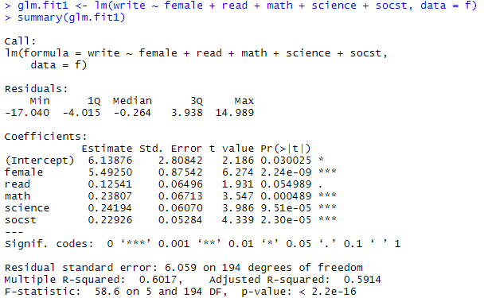
Multiple regression
Y = 0.030025 + (2.24e-09*female) + (0.000489*math) + (9.51e-05*science) + (2.30e-05*socst)

Slide 28
Conclusion
Question: Can we predict writing scores for students according their gender and other test results?
Answer: Yes, it is possible now to predict writing score from gender of student and his test scores.

Slide 29
Thank you for attention!

